Slide 1
Troubleshoot Network Connectivity

Slide 2

Lessons
Troubleshoot a network connectivity issue
Troubleshoot name resolution
Troubleshoot remote access

Slide 3
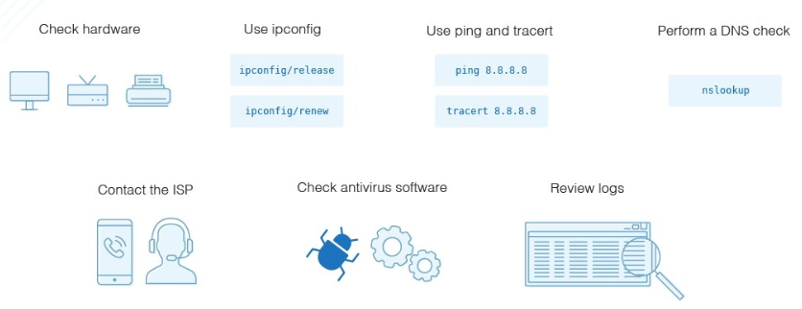
Troubleshoot Network Connectivity
Troubleshooting network connectivity issues on Windows 11 involves identifying and resolving problems that may arise in different aspects of the network like troubleshoot network connectivity, name resolution, and remote access issues
Notes:
Remote administration is a critical aspect of IT management, allowing administrators to efficiently oversee and maintain Windows 11 systems without physical access to each machine. These administration tools empower users to manage and troubleshoot Windows 11 systems efficiently. Whether through graphical interfaces like Windows Admin Center or command-line tools like PowerShell, these tools offer flexibility and control over system administration tasks.

Slide 4
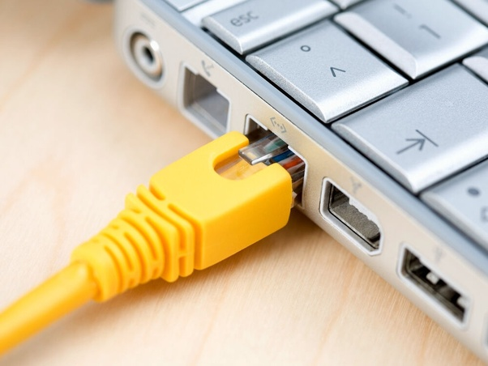
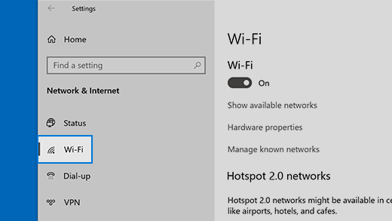
Check Physical Connections:
Ensure that cables are securely connected.
If using Wi-Fi, make sure the wireless adapter is enabled and connected to the correct network.

Slide 5
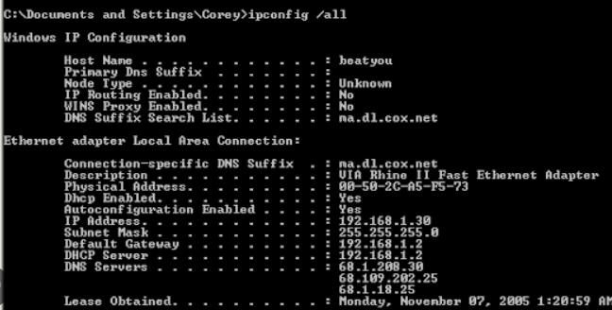
Verify IP Configuration
Open Command Prompt and type ipconfig /all to check if the IP address, subnet mask, gateway, and DNS servers are correctly configured.

Slide 6
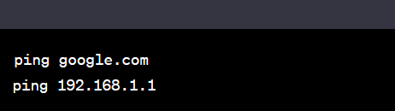
Ping Test
Use the ping command to test connectivity to other devices on the network or the internet.

Slide 7
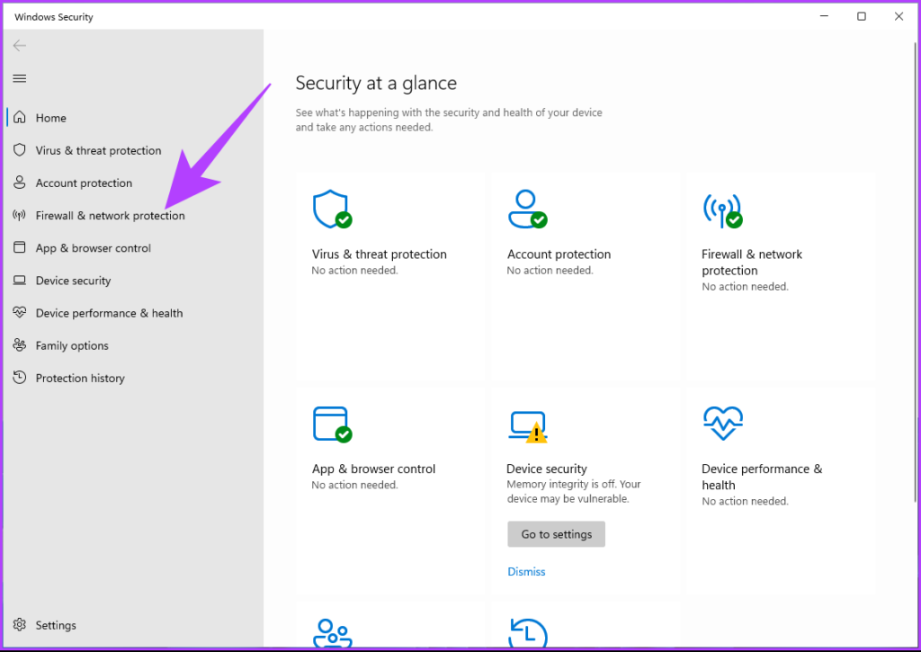
Firewall and Antivirus
Temporarily disable the firewall or antivirus software to check if they are blocking the network connection.

Slide 8
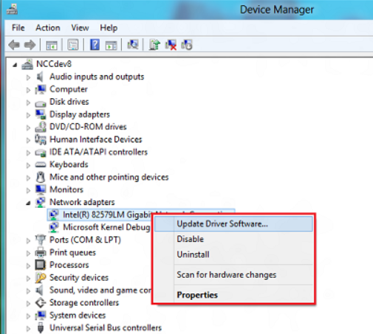
Device Manager
Check Device Manager for any issues with network adapters. Update or reinstall drivers if necessary.

Slide 9
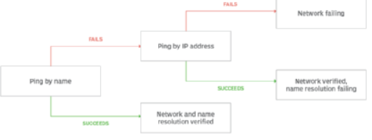
Troubleshoot Name Resolution:
Network administrators can troubleshoot name resolution using a variety of methods, including ping, nslookup and PowerShell cmdlets.
Notes:
Name resolution is the process of matching the name of a computer to its network address. This module looks at name resolution issues for public networks, private networks, and internal networks

Slide 10
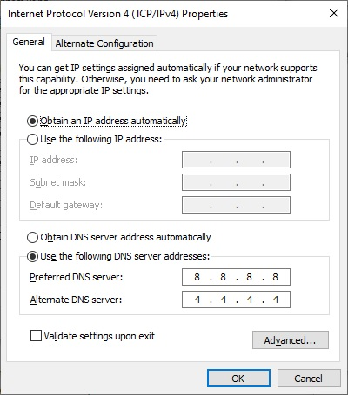
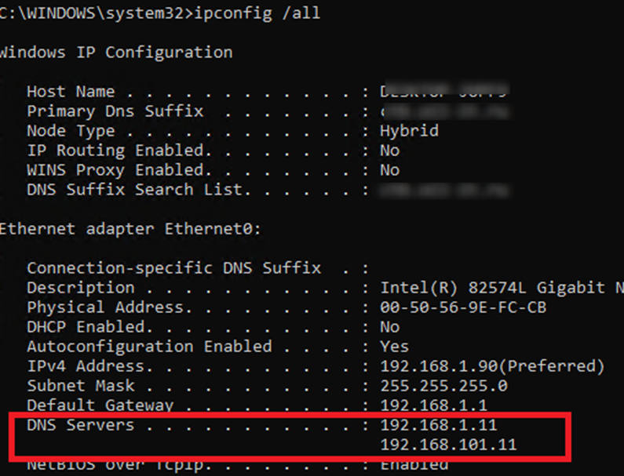
DNS Configuration
Verify DNS settings by checking the DNS server addresses in your network adapter settings.

Slide 11
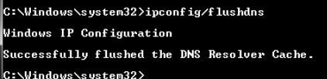
Flush DNS Cache
Open Command Prompt and type ipconfig /flushdns to clear the DNS resolver cache
Notes:
https://techdirectarchive.com/2022/01/07/how-to-install-windows-admin-center-on-windows-10-11/

Slide 12
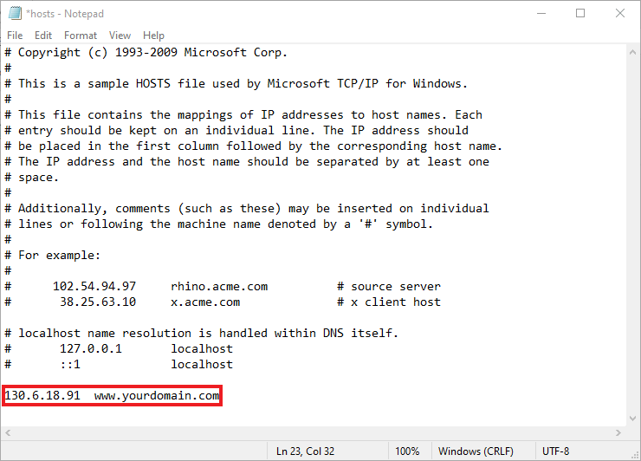
Hosts File
Check the hosts file (C:\Windows\System32\drivers\etc\hosts) for any incorrect entries

Slide 13
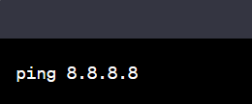
DNS Server Reachability
Ping the DNS server to ensure it is reachable

Slide 14



Nslookup
nslookup is a command-line tool available in Windows and many other operating systems. It is used for querying Domain Name System (DNS) servers to obtain domain name or IP address mapping, DNS records, and other DNS-related information. Here are some common uses of the nslookup command:
Basic DNS Query:
Reverse DNS Lookup
Query a Different Record Type:

Slide 15
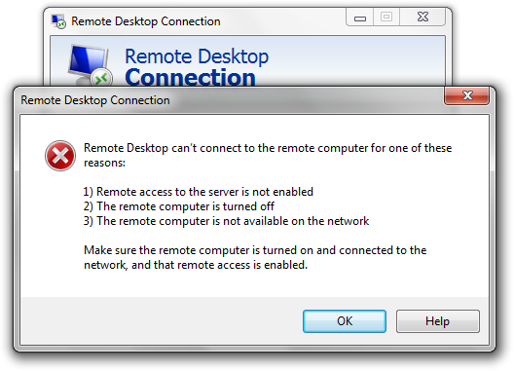
Troubleshoot Remote Access
Troubleshooting remote access issues can involve a variety of steps, depending on the specific method of remote access being used.

Slide 16
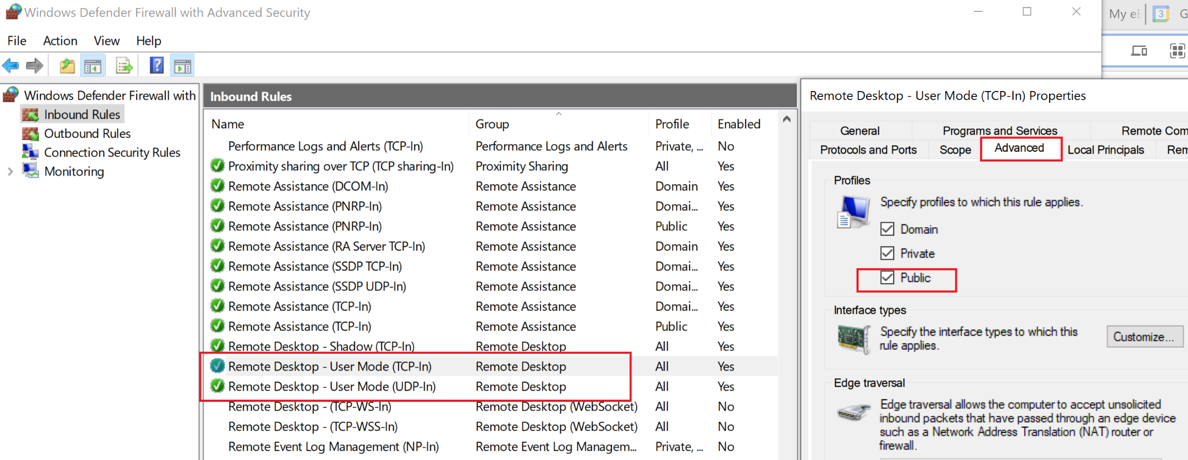
Firewall Settings
Ensure that the firewall allows remote access. Check the settings for any rules blocking remote connections.

Slide 17
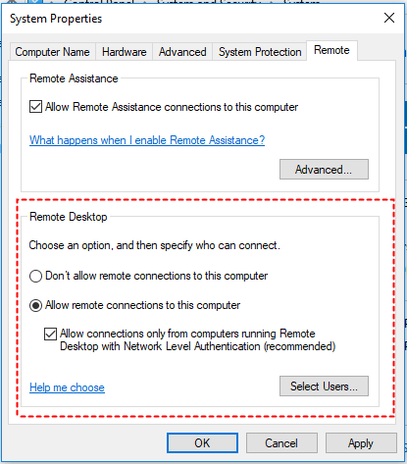
Remote Desktop Protocol (RDP)
If using RDP, make sure it's enabled on the remote machine

Slide 18
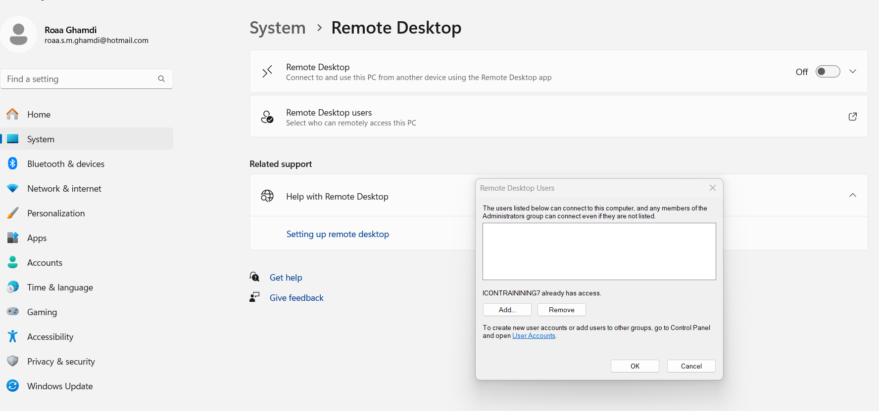
User Permissions
Check that the user account has the necessary permissions for remote access.

Slide 19
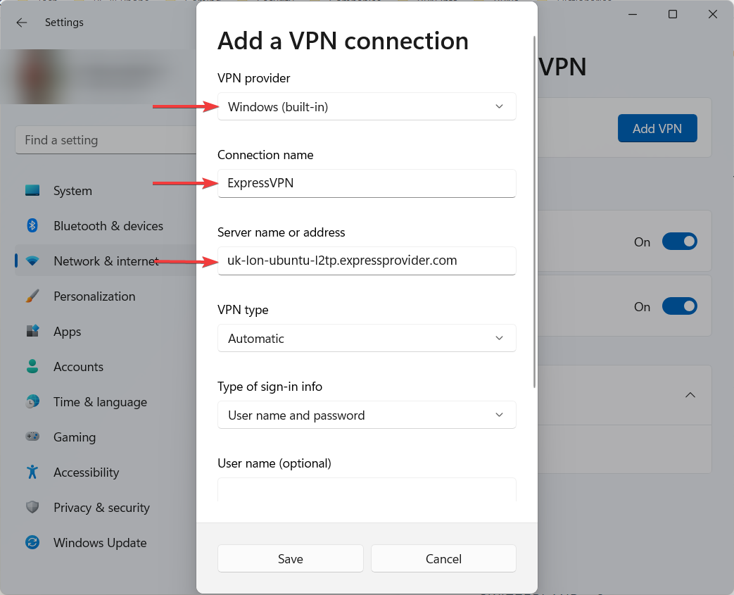
VPN Connection
If remote access involves a Virtual Private Network (VPN), ensure that the VPN connection is established successfully.
Verify the VPN settings and credentials.

Slide 20
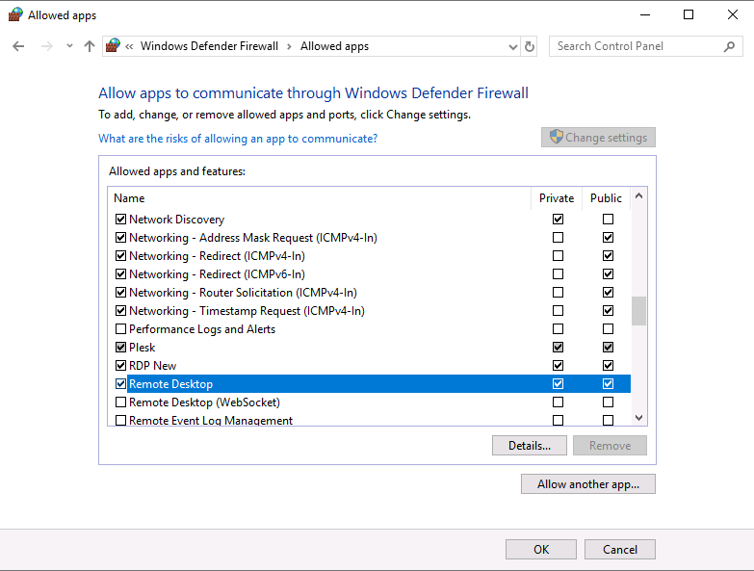
Security Software
Check if security software (antivirus, anti-malware) on either the local or remote machine is blocking the remote access.

